Slide 1
Gender and Age Detection With Data Science
Submitted in the partial fulfillment for the award of the degree
Of
BACHELOR OF ENGINEERING
IN
COMPUTER SCIENCE WITH SPECIALIZATION IN
ARTIFICIAL INTELLIGENCE AND MACHINE LEARNING
Submitted by:
21BCS11244 - SHASHANK
21BCS11658 - SAHIL TOMAR
21BCS11602 - ARYAN NEGI
21BCS11322 - DHRUV
Under the Supervision of:
Ms. Anudeep Kaur
Department of AIT-CSE
DISCOVER . LEARN . EMPOWER

Slide 2
Outline
Introduction to Project
Problem Formulation
Objectives of the work
Methodology used
Conclusion
References

Slide 3
Introduction to Project
This project focuses on developing a data-driven model for automatic gender and age detection using facial images. By leveraging the Adience dataset, we aim to design and train a Convolutional Neural Network (CNN) that can accurately classify gender and predict age ranges. The model will be optimized for real-time applications, making it suitable for use in various domains such as recruitment, marketing, and security. Through rigorous validation and testing, we will ensure that the system is reliable, efficient, and capable of performing well in real-world scenarios.

Slide 4
Problem Formulation
Facial analysis from images has garnered significant attention due to its ability to address various challenges, such as enhancing ad targeting for customers, improving content recommendation systems, bolstering security surveillance, and benefiting other fields as well.
Age and gender are crucial components of facial attributes, and accurately identifying them is a fundamental aspect of facial analysis, serving as an essential step for tasks in this domain.
This project focuses on developing a data-driven model for automatic gender and age detection using facial images. By leveraging the Adience dataset, we aim to design and train a Convolutional Neural Network (CNN) that can accurately classify gender and predict age ranges.

Slide 5
Objectives of the Work
Develop an Accurate Gender and Age Classification Model: Implement CNNs to accurately classify gender into 'Male' or 'Female' categories and age into specific ranges,), and more, based on facial images.
Ensure Accessibility and Ease of Use: Create a user-friendly system that requires minimal equipment, making it accessible to a broad audience, including non-professionals.
Enhance Application in Multiple Domains: Adapt the model to work effectively in diverse fields such as recruitment, where it can help verify candidates' age and gender, and in marketing, where it can assist in customer segmentation.

Slide 6
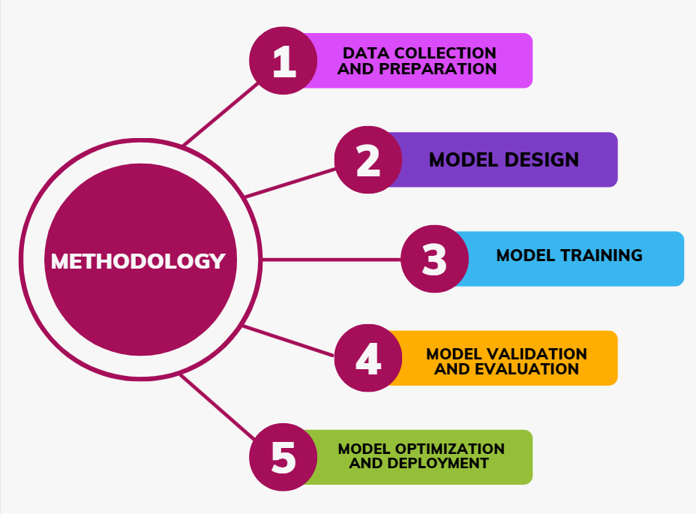
Methodology used

Slide 7
Methodology used
Data Collection and Preparation : We will utilize the Adience dataset, containing over 26,000 images, to build our model. The images will be standardized through resizing and data augmentation techniques like rotation and flipping to enhance diversity. Pixel values will be normalized, and categorical labels (gender and age) will be encoded numerically for model processing.
Model Design : The model will be a Convolutional Neural Network (CNN) tailored for facial feature extraction. It will use ReLU and Softmax activation functions, pooling layers to reduce data dimensions, and dropout regularization to prevent overfitting, ensuring an accurate and efficient model.
Model Training : The dataset will be split into training, validation, and testing subsets. We’ll use an optimizer like Adam or SGD and categorical cross-entropy as the loss function. Hyperparameters such as learning rate, batch size, and epochs will be fine-tuned for optimal model performance.

Slide 8
Methodology used
4. Model Validation and Evaluation: The model’s performance will be validated using k-fold cross-validation and metrics like accuracy, precision, recall, and F1-score. A confusion matrix will help identify misclassification patterns, guiding further improvements.
5. Model Optimization : To enhance efficiency, the model will undergo pruning and quantization. GPU acceleration will be used during training and inference to speed up processes, making the model suitable for real-time applications and low-resource devices.
6. Deployment :The optimized model will be integrated into a user-friendly system for real-time gender and age detection, using OpenCV for webcam input. The system will be tested in practical scenarios like recruitment and marketing, with user feedback guiding further refinements.

Slide 9
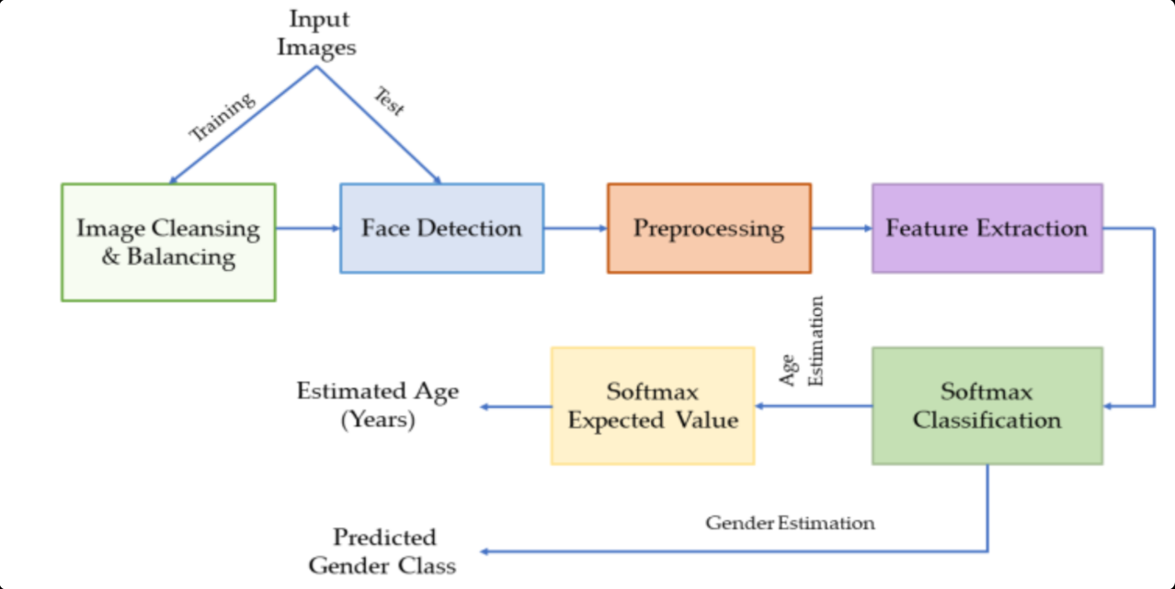
Model working Flow Chart

Slide 10
Conclusion
The "Gender and Age Detection Using Data Science" project is set to create a versatile, accurate, and user-friendly tool that can be deployed across various industries. By integrating cutting-edge machine learning techniques with accessible technology, this project will provide essential tools for gender and age classification, driving advancements in fields such as recruitment, security, and marketing.

Slide 11
References
G. Levi and T. Hassner, "Age And Gender Classification Using Convolutional Neural Networks", Proceedings Of The Ieee Conference On Computer Vision And Pattern Recognition Workshops, 2015.
G. Antipov, M. Baccouche, S.A. Berrani and J.L. Dugelay, "Effective Training Of Convolutional Neural Networks For Face-based Gender And Age Prediction", 2017.
K. Ito, H. Kawai, T. Okano and T. Aoki, "Age And Gender Prediction From Face Images Using Convolutional Neural Network", 2018.
Hou C, Kalantarian H, Washington P, Dunlap K, Wall DP. 2021. Leveraging video data from a digital smartphone autism therapy to train an emotion detection classifier.

